Slide 1
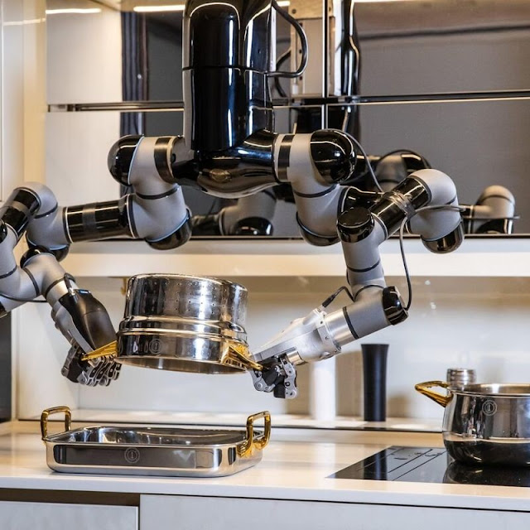
SmartKitchenHelper Project
Amit Christian - 100937637
Shukan Thakkar - 100944139
Sagar Parmar - 100942558
Shanmugapriya Karunanithi - 100961276
Thet Hnin - 100961276
Dhanya Undavalli - 100966131

Slide 2

Overview
The SmartKitchenHelper project is an innovative and comprehensive web application designed to address modern kitchen management challenges. It combines SQL and NoSQL databases to offer flexibility, scalability, and high availability, providing a centralized solution for ingredient tracking, recipe discovery, and meal planning.

Slide 3
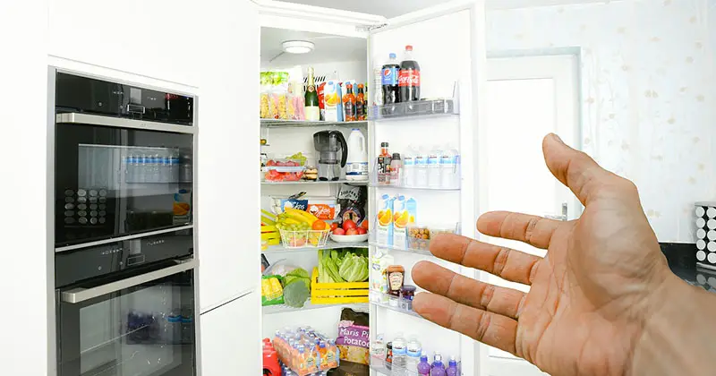
Objective of the Project
The main objectives of the SmartKitchenHelper project include:
- Centralized Management of Multiple Households
- Efficient Ingredient Tracking and Inventory Management
- Recipe Discovery and Personalized Meal Planning
- Integration of Structured and Unstructured Data
- High Availability, Scalability, and Performance
- Data Security, Privacy, and Compliance
- User-Friendly Interface and Accessibility

Slide 4
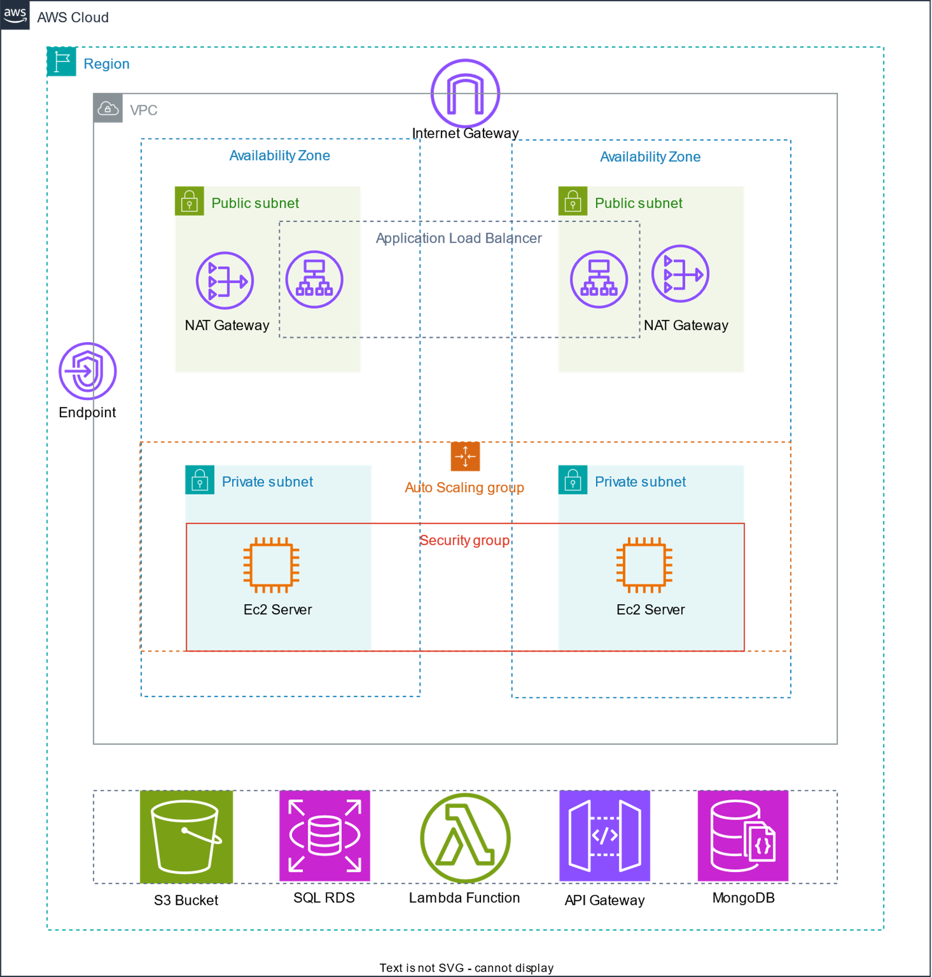
Architecture
The architecture of SmartKitchenHelper is designed to balance performance, scalability, and security. It includes components like the frontend (React.js), backend (Node.js), SQL Database (PostgreSQL), NoSQL Database (MongoDB), middleware for security, and AWS cloud infrastructure for deployment.

Slide 5
System Working - Frontend
The frontend is built using React.js, providing a dynamic and responsive user interface. Key features include user authentication, household and ingredient management, recipe discovery, and a responsive design for cross-platform accessibility.

Slide 6

System Working - Backend
The backend is developed with Node.js and Express.js, handling all business logic, data processing, and database interactions. It includes user management, role-based access control, inventory control, recipe management, and API integration.

Slide 7

System Working - SQL Database
PostgreSQL is used as the relational database to manage structured data. Key tables include Users, Households, Ingredients, Recipes, and User Recipe History, ensuring data integrity and efficient querying.

Slide 8

System Working - MongoDB Database
MongoDB manages unstructured data, such as recipe instructions, images, and user preferences. It provides flexible schema design, enabling the storage of diverse and hierarchical data, integrated with the SQL database.

Slide 9

System Working - Middleware and Routes
Middleware components handle authentication (JWT), input validation, and error handling. API routes manage user registration, household management, ingredient management, and recipe retrieval, ensuring secure and efficient processing.

Slide 10
Technical Challenges
The project faced challenges including:
- Data synchronization between SQL and NoSQL databases
- Scalability to handle increasing user demand
- Security, including encryption and JWT authentication
- API integration for external services like YouTube

Slide 11

Future Scope
The future scope includes:
- AI-driven recipe suggestions
- Mobile application development for iOS and Android
- Smart kitchen integration with IoT devices
- Advanced analytics for ingredient usage and dietary habits
- Expansion to Azure with AKS for containerized deployment

Slide 12
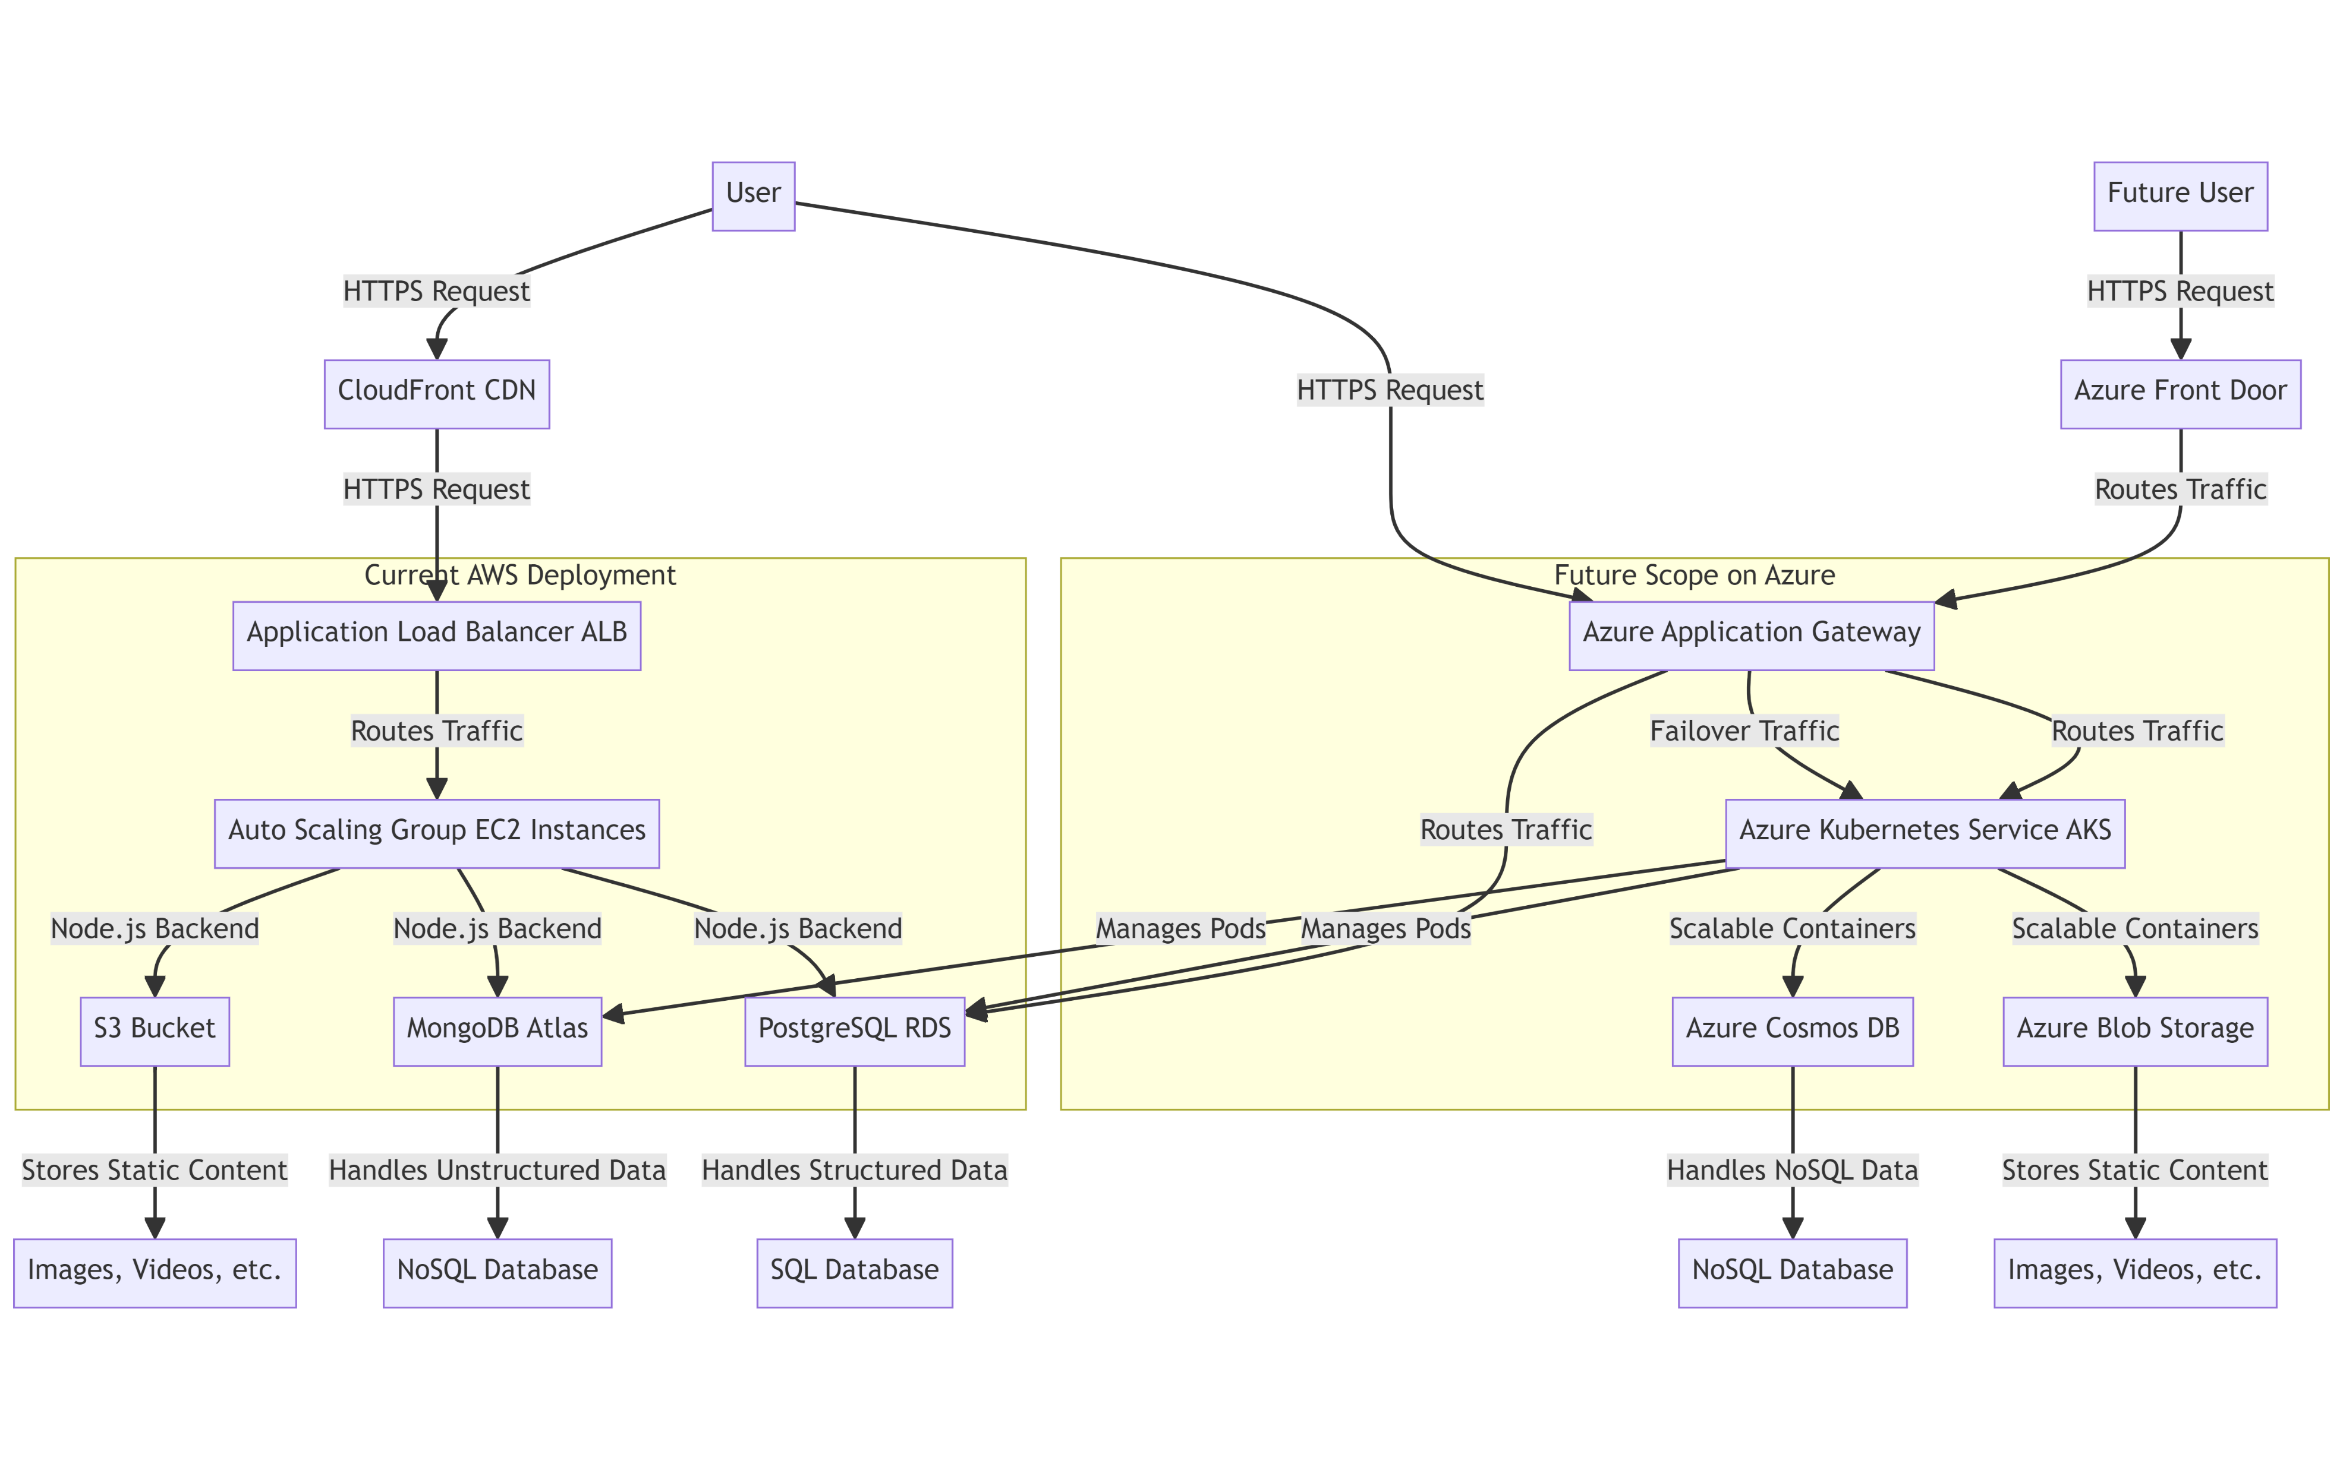
AWS Deployment Details
The SmartKitchenHelper system is deployed on AWS, utilizing:
- VPC for network isolation
- EC2 instances for backend services
- RDS (PostgreSQL) for relational data
- MongoDB Atlas for NoSQL data
- S3 for static assets
- ALB for traffic distribution
- Auto Scaling for dynamic resource management

Slide 13
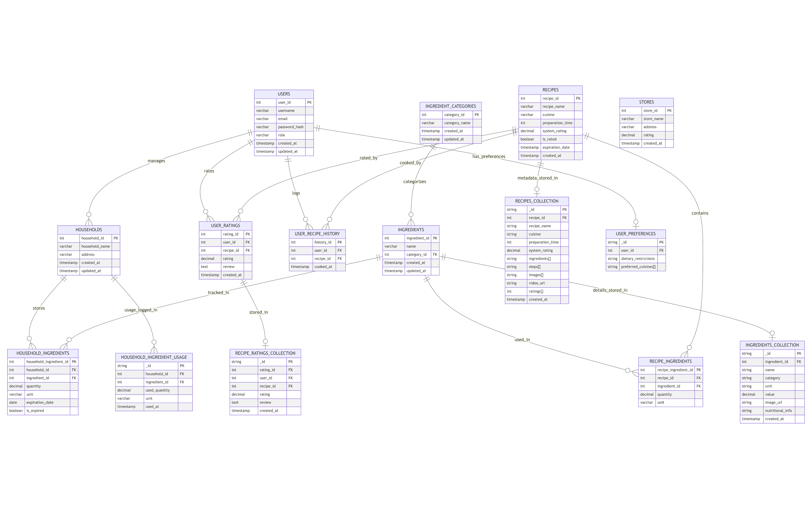
Screenshots of SQL and NoSQL Deployment
This section includes screenshots of the database deployments, showcasing the SQL ER diagram and MongoDB collections.

Slide 14

Conclusion
SmartKitchenHelper demonstrates the effective integration of cloud computing, database management, and modern web development. The project successfully addresses challenges and lays the groundwork for future enhancements, making it a robust solution for kitchen management.

Slide 15

tHank you

